Slide 1

CLASS-BASED GRAPH ANONYMIZATION FOR SOCIAL NETWORKS DATA PROTECTION AND PRIVACY
Daniele Scala 4840112
Samuele Crea 4868097
Alessio Malerba 4858043

Slide 2
AIM OF THE PROJECT
When an enterprise needs to send the data of its users to another company (e.g., analysts), it is necessary to anonymize their identities, as attackers may attempt to derive sensitive information.
What we propose is a model for data anonymization based on masking the identities of social network users.

Slide 3
WHAT IS CLASS-BASED ANONYMIZATION
Class-based anonymization is an algorithm that exploits features typical of naive approaches and clustering approaches.
More specifically exploits the creation of subgroups ( = classes) that do not allow third parties to distinguish the identity of each user belonging to the same class.

Slide 4

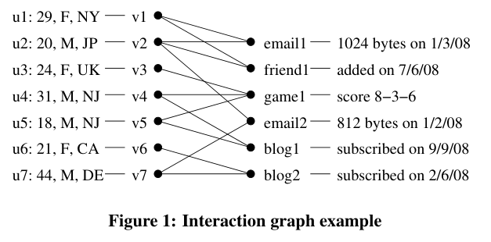
OUR SOCIAL NETWORK
The required domain is a bipartite nondirected graph in which you have one set of nodes representing users, and a second set of nodes representing interactions between them.
In this way it is possible to represent a relationship between two users U1 and U2 , for example “friendship”, if in a certain node I1 of the second set there is an arc going toward U1 and a second arc going toward U2.
This graph is called “interaction graph”.

Slide 5
OUR SOCIAL NETWORK
We used networkX library to generate a bipartite random graph, non following scale-free properties because of the bipartite structure and the need of adjusting the degree of the interaction nodes.
The algorithm needs to handle with a sparse graph, and to check why, we allow to select manually the density, to see the differences.
We chose to generate a fake new social network in which there are three types of interactions:
Friendship, between 2 people;
Message, between 2 people;
Blog, between up to 4 people.

Slide 6
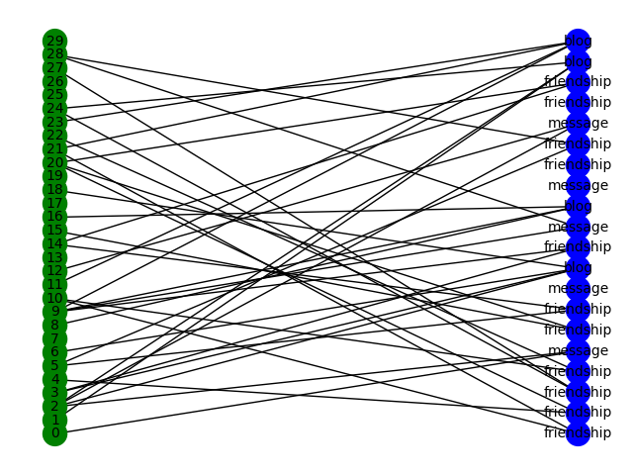

Slide 7
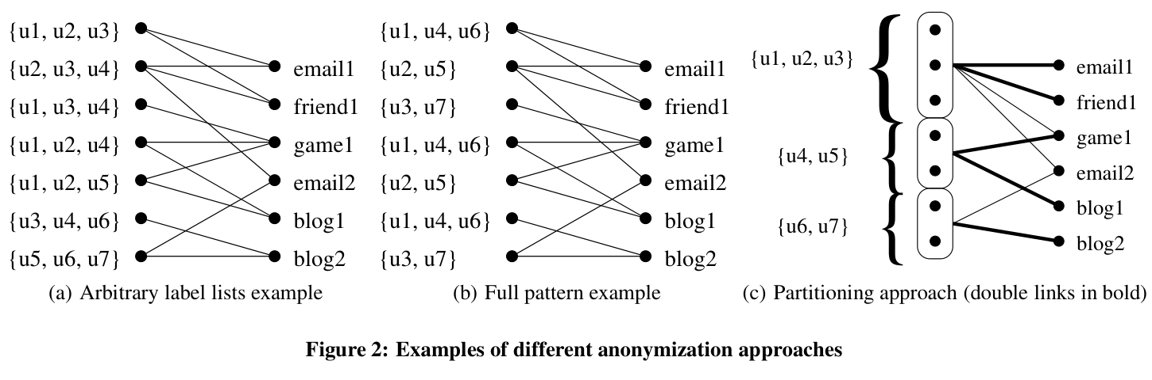
THE THREE ANALYZED APPROACHES
Label lists
(Arbitrary lists approach)
Label lists
(uniform lists approach)
[full pattern case]
Partitioning approach

Slide 8

ARBITRARY LIST APPROACH
We create, for each node, a list of m labels that includes the node identifier itself plus other m-1 nodes, and then replace its parameter with this set.
While it may initially seem impossible for an adversary to determine the true label for each entity, certain cases can inadvertently reveal information.
For example, the label "u7" in the previous image is uniquely associated with the last node, providing a potential security vulnerability, because we can infer also the identity of u5 and u6 and the fact that they share blog2!
we therefore need a method that helps prevent these kinds of leaks by providing a criterion for the inclusion of a certain label in a certain set

Slide 9
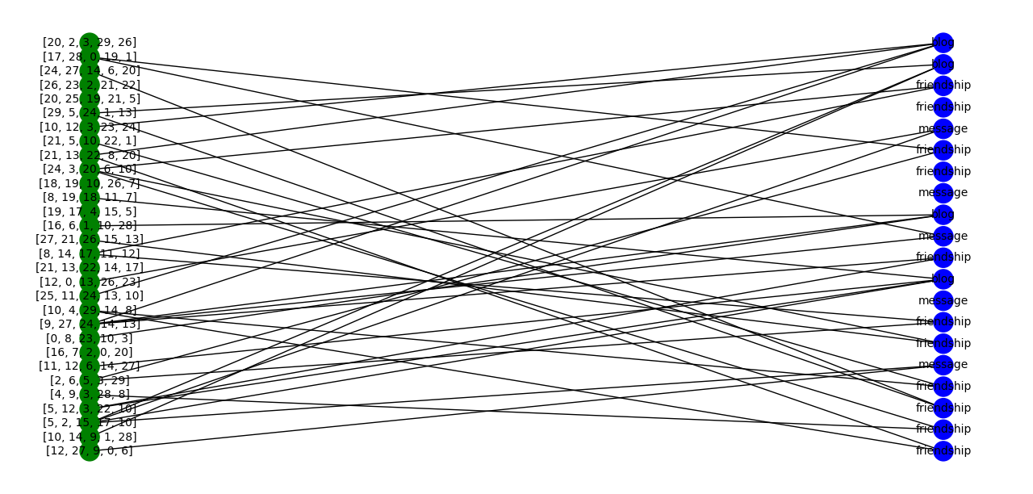
ARBITRARY LIST APPROACH

Slide 10
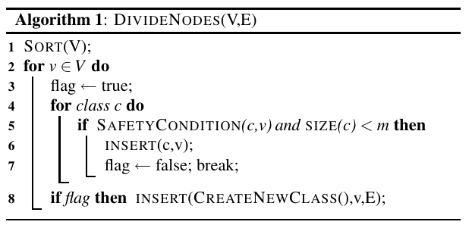
UNIFORM LIST APPROACH → FULL-PATTERN CASE
Here we generate sets of lists which are more structured, avoiding “static” attacks, and retaining privacy in the face of attacks based on background knowledge
Nodes now are divided in classes of size m, then we create for each class a set of lists (one per node), based on a parameter k ≤ m
Lists are built deterministically from the set of nodes in the class so that an attacker has a low probability of guessing the correct label
Based on the values chosen for m and k, we face the trade off between utility and privacy, so the choice may vary depending on context and need

Slide 11
UNIFORM LIST APPROACH → FULL-PATTERN CASE
For the definition of the list generation method, we can use special cases of the approach based on the values chosen for a pattern p and k (= size of p)
The pattern (which must contain the value 0 to allow the real identifier to be entered), cyclically allows the values to shift, generating the lists symmetrically.
Full-pattern method is a special case, since here we have k = m, so each label list contains all the elements of the class.
It is based in turn on the "prefix-pattern" method, that is, with p = {1,2,3,...,k-1}
In this case, if m is too large, utility is lost, maximizing privacy.
however, if a modest value of m is used, the method is optimal.

Slide 12
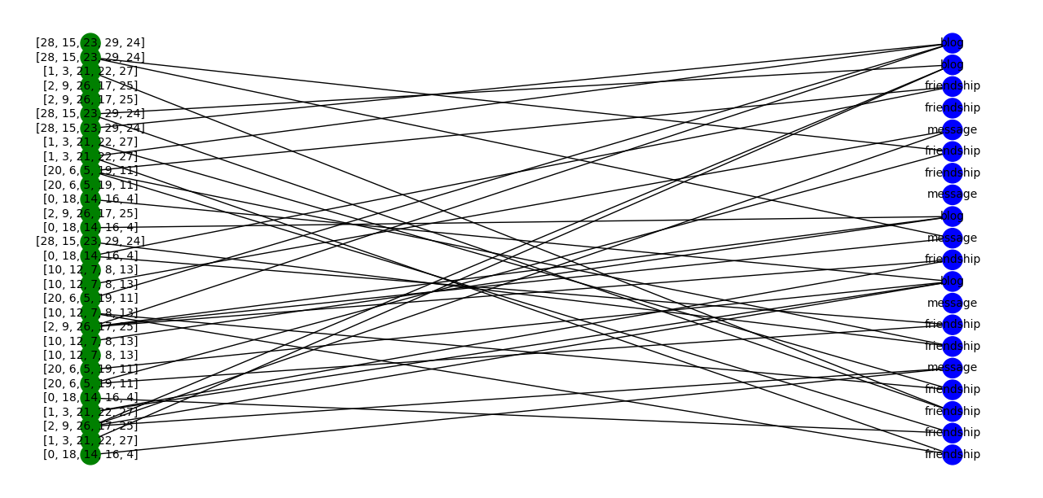
FULL-PATTERN LIST APPROACH

Slide 13

PARTITIONING APPROACH
An attacker who has information about one node and partial information about other related nodes can combine this with data anonymized by the uniform list approach to infer more about the interactions between those nodes for which partial information is known.
To preclude such attacks which leverage greater amounts of background information, we increase the amount of masking of data, at the expense of utility.
This leads us to a partitioning approach, which partitions the nodes into classes. In this case, only the number of edges between (and within) each subset is released
This a form of generalization technique, to be used in bipartite graphs.

Slide 14
PARTITIONING APPROACH
Again, a safety condition is needed to prevent inference, and the same as in the previous case can be used, thus creating the classes in the same way.
In this way we can predict the attacker's use of density to conclude the participation probability of a certain entity in a class.
We also limit the impact of background knowledge by the attacker.

Slide 15
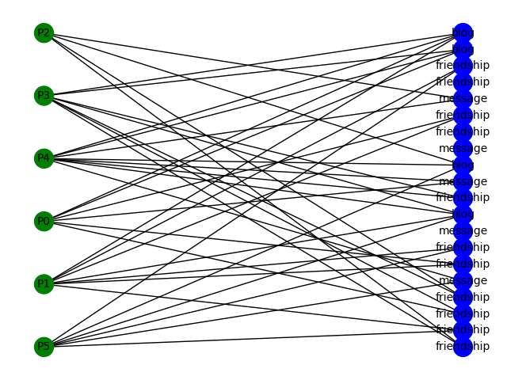
PARTITIONING APPROACH

Slide 16
STRUCTURE OF THE CODE
The code is divided into 3 files: 1) graph generation 2) class-based anonymization algorithm 3) graph printing functions
The graph when generated is put into a csv file, so we can use the data from that file, simulating a verisimilar experience, to apply anonymization via the class-based algorithm.
Depending on the type of anonymization simulated (via the --type command → {"arbitrary-lists", "uniform-lists", "partitioning"}), the algorithm uses the functions designated to the choice and calls the graph drawing function with the appropriate variables.
During the process, all node information is printed to the terminal, but we did this only for debugging and operation monitoring purposes

Slide 17

OUR CONCLUSIONS → PRIVACY
In general, the analyzed methods are sufficient solutions for protecting our data when we want to hide them from external attackers who try to identify users without having background knowledge.
The first approach, as we have seen, lacks in structure, as an "unfortunate" randomization can lead to the recognition of a group of users.
The use of structured lists overcomes this obstacle but cannot ensure protection when the attacker has partial knowledge about some nodes.
Thus, we can conclude that to avoid attacks based on background information, partitioning is the most suitable approach.

Slide 18
OUR CONCLUSIONS → UTILITY
Using the label lists algorithm, the tradeoff between privacy and utility is affected by the choice we make for the parameters k and m: depending on the amount of privacy required we generate larger class sizes, at the expense of utility.
The partitioning approach involves choosing parameter m, which again can decree how much utility we want to pay for higher privacy.
Usually, however, generalization of identifiers offers less chance of tracing back to individual identities, so the quality of masking is already better because of the intrinsic structure of the generated graph
One mechanism that can be employed is to weight the arcs according to the original association count. This provides less privacy, but if required by the intended analysis, it gives more information that can be used for it.

Slide 19
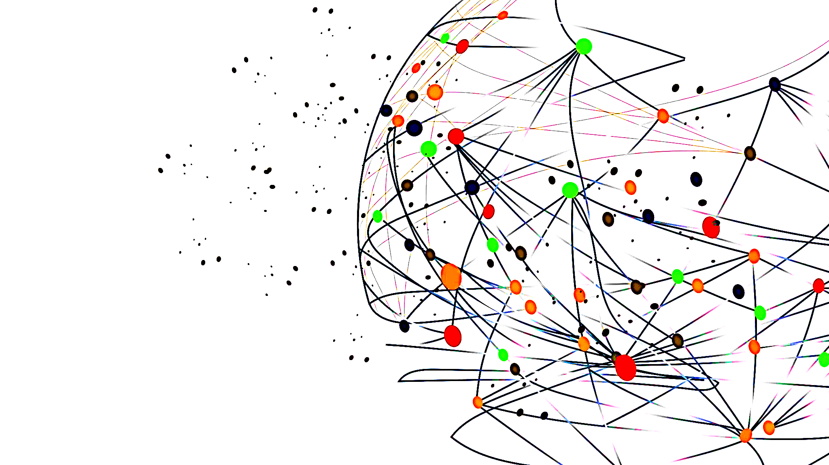
THANK YOU FOR THE ATTENTION!

